Slide 1

CREDIT CARD WEEKLY STATUS REPORT

Slide 2
PROJECT OBJECTIVE
To develop a comprehensive credit card weekly dashboard that provides real-time insights into key performance metrics and trends, enabling stakeholders to monitor and analyze credit card operations effectively

Slide 3
IMPORT DATA TO DATABASE
Download raw data from GITHUB.
Prepare csv file.
Create tables in POSTGRESQL.
Import csv file into POSTGRESQL.
Make connection between POSTGRESQL AND POWER BI.
Last making dashboard in POWER BI

Slide 4
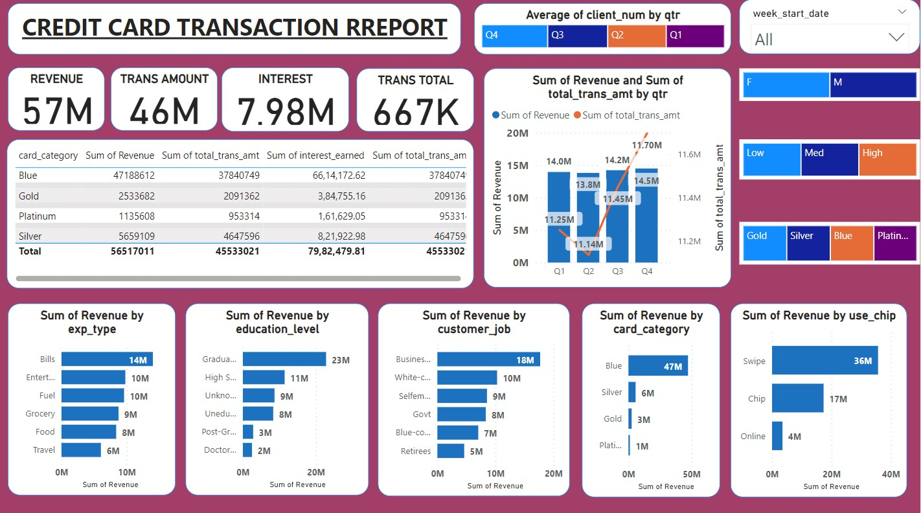
CREDIT CARD FINANCIAL DASHBOARD-TRANSACTION

Slide 5
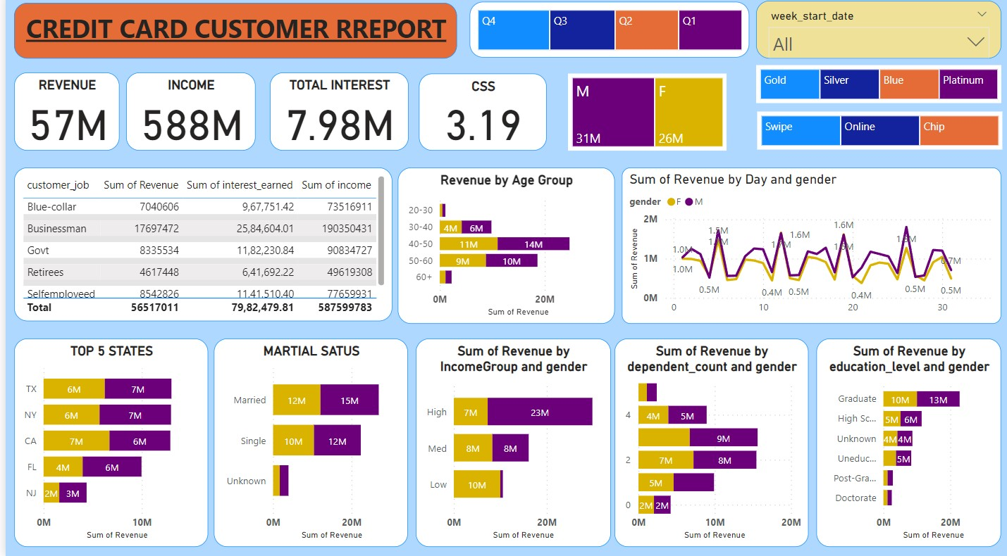
CREDIT CARD FINANCIAL DASHBOARD-CUSTOMER

Slide 6
PROJECT INSIGHTS WEEK 53
WEEK ON WEEK CHANGE :
Revenue increased by 28.8%.
Total Transaction Amt & Count increased by 35.03% & 3.3%.
Customer count increased by 16%.
Customer Income increased by 12.3%.
Customer Satisfaction decreased by 6.5%.

Slide 7
OVERVIEW YEAR TO DATE PROGRESS OF CUSTOMER CREDIT CARD
Overall revenue is 57M
Total interest is 8M
Total transaction amount is 46M
Male customers are contributing more in revenue 31M, female 26F
Blue & Silver credit card are contributing to 93% of overall transactions Texas, New York & California is contributing to 68%
Overall Activation rate is 57.5%
Overall Delinquent rate is 6.06%
Overall Delinquent based on the job category 1.66%(SelfEmployeed)

Slide 8
DAX QUERIES
AgeGroup = SWITCH
( TRUE(),
'public cust_detail'[customer_age] < 30, "20-30",
'public cust_detail'[customer_age] >= 30 && 'public cust_detail'[customer_age] < 40, "30-40",
'public cust_detail'[customer_age] >= 40 && 'public cust_detail'[customer_age] < 50, "40-50",
'public cust_detail'[customer_age] >= 50 && 'public cust_detail'[customer_age] < 60, "50-60",
'public cust_detail'[customer_age] >= 60, "60+", "unknown"
)
IncomeGroup = SWITCH( TRUE(,
'public cust_detail'[income] < 35000, "Low",
'public cust_detail'[income] >= 35000 && 'public cust_detail'[income] = 70000, "High",
"unknown
)

Slide 9
DAX QUERIES
week_num2 = WEEKNUM('public cc_detail'[week_start_date])
Revenue = 'public cc_detail'[annual_fees] + 'public cc_detail'[total_trans_amt] + 'public cc_detail'[interest_earned]
Current_week_Reveneue = CALCULATE(
SUM('public cc_detail'[Revenue]),
FILTER( ALL('public cc_detail’),
'public cc_detail'[week_num2] = MAX('public cc_detail'[week_num2])))
Previous_week_Reveneue = CALCULATE(
SUM('public cc_detail'[Revenue]),
FILTER(
ALL('public cc_detail’),
'public cc_detail'[week_num2] = MAX('public cc_detail'[week_num2])-1))

